Slide 1
Flu Strains, Hospitality, and Mortality
Walter Hamson
Christian Blomgren
Jay Manion

Slide 2
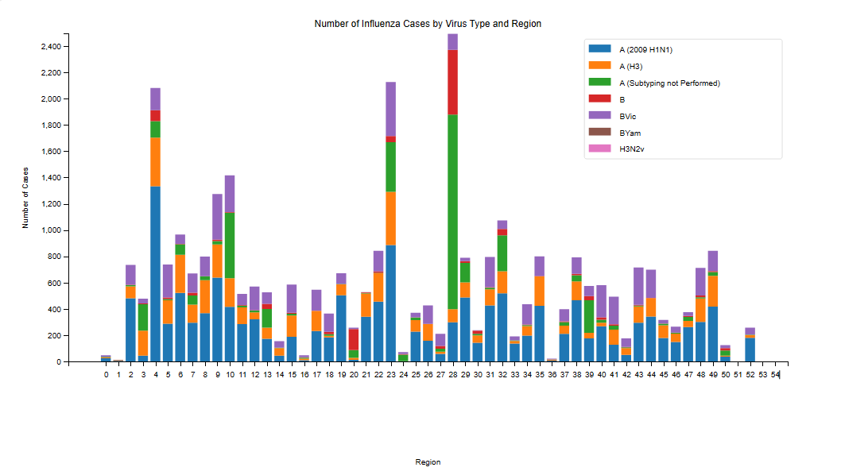
Strains – Walter
x

Slide 3
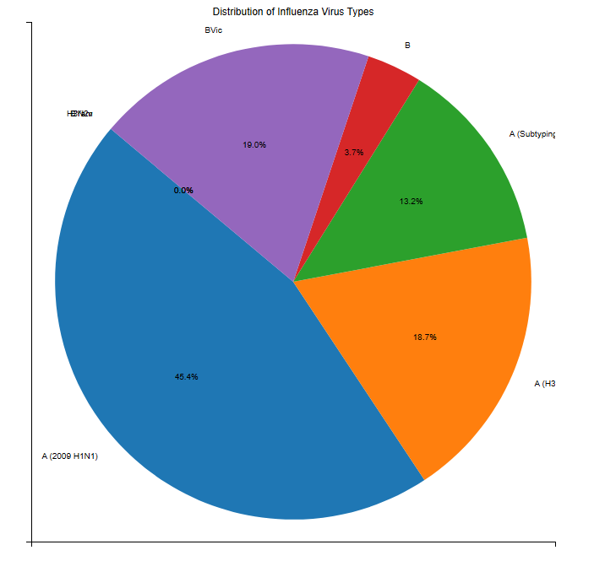
Strains – Walter
x

Slide 4
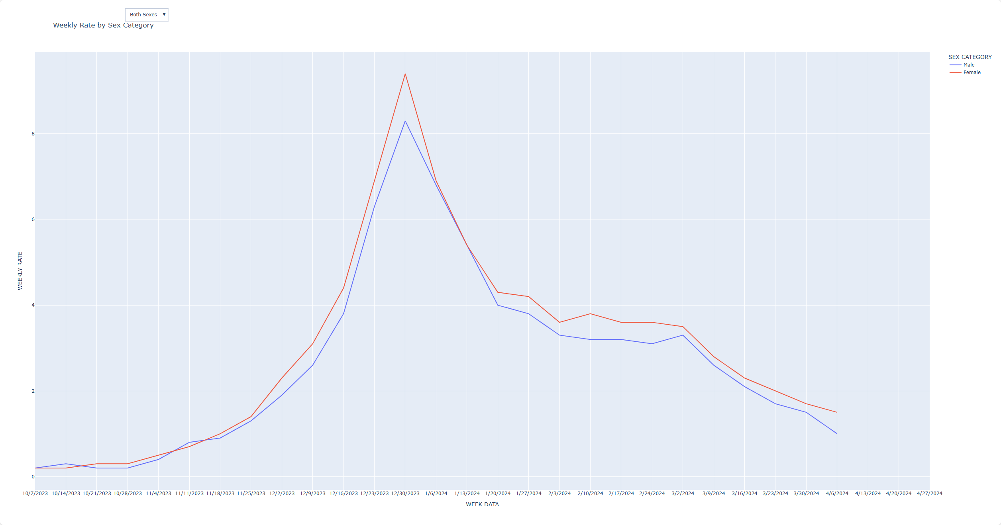
Hospitalizations by Sex - Jay
While both are very similar trends, female pulls ahead during the peak
Females peak at 9.4 weekly rate
Males peak at 8.3 weekly rate

Slide 5
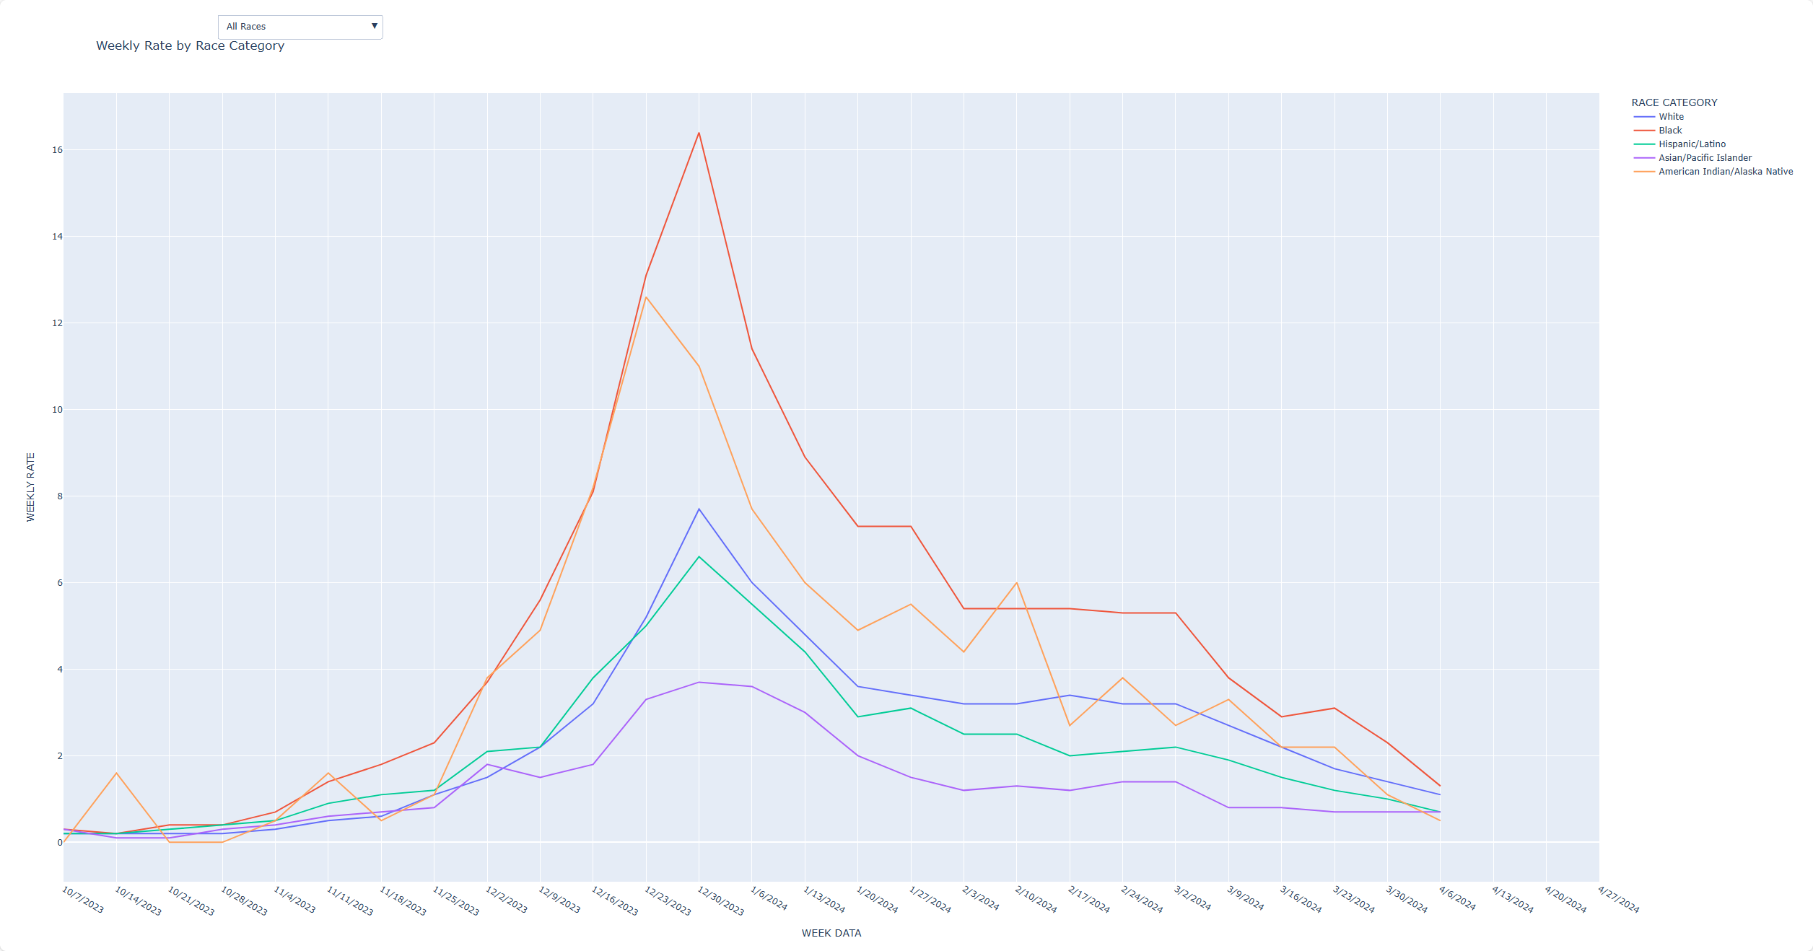
Hospitalizations by Race- Jay
As far as race, Black is the most susceptible to hospitalizations
Peaking at 16.4 weekly rate
Next is American Indian / Alaska Native
Peaking at 11.0 weekly rate

Slide 6
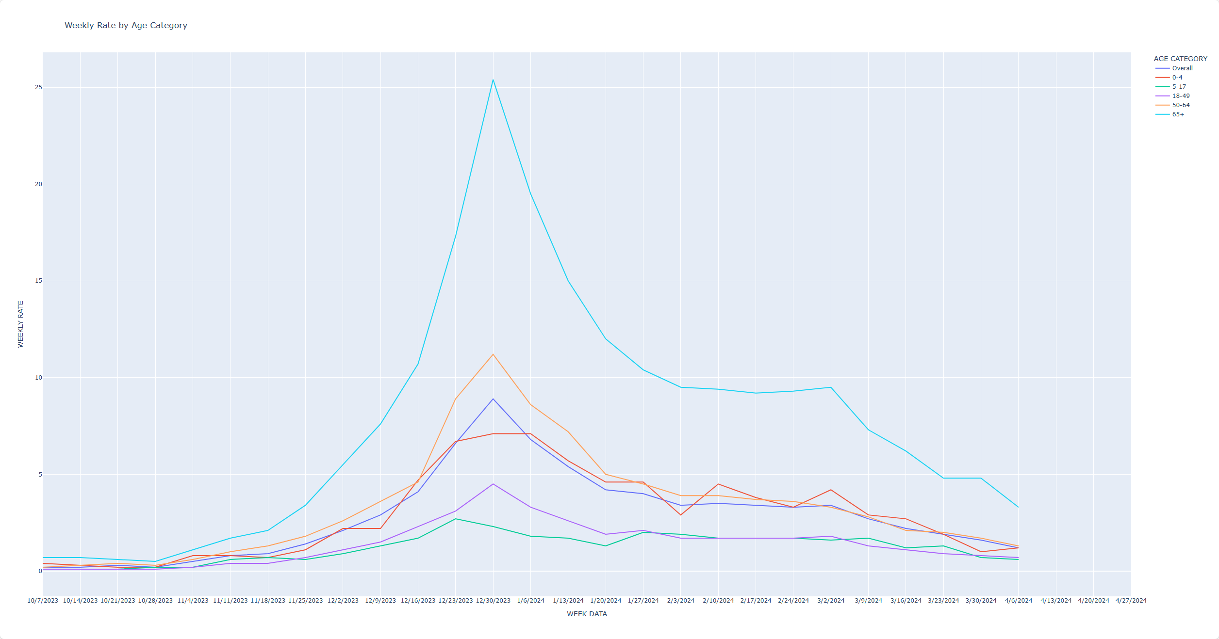
Hospitalizations by Age - Jay
65+ years old is the most susceptible
Peaking at 25.4 weekly rate
Next highest is 50-64
Peaking at 11.2 weekly rate

Slide 7
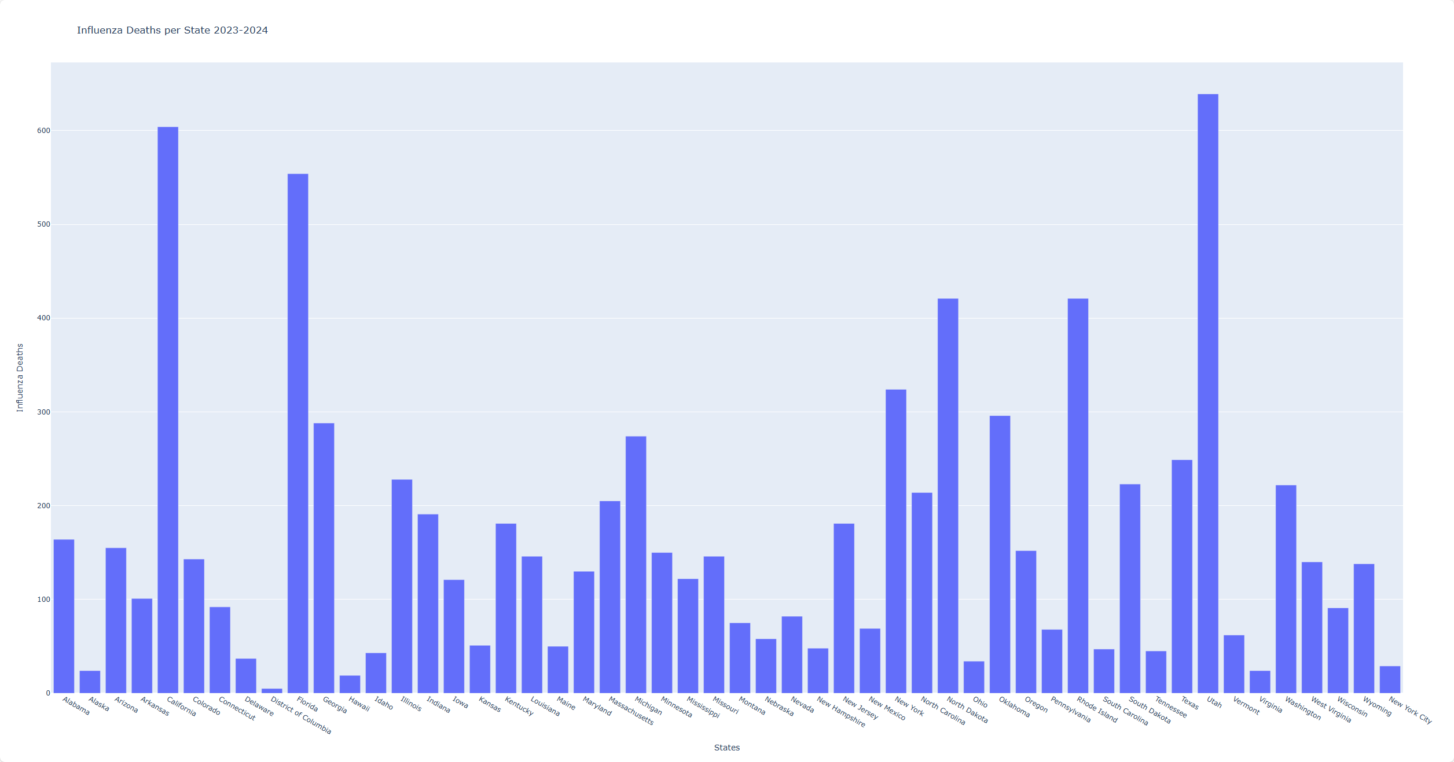
Mortality - Christian
x

Slide 8
Wrap-up
GitHub link to project
ChristianBlomgren/flu-season-vacay-project (github.com)
Data link
https://www.cdc.gov/flu/

Slide 9
Questions?

